Slide 1
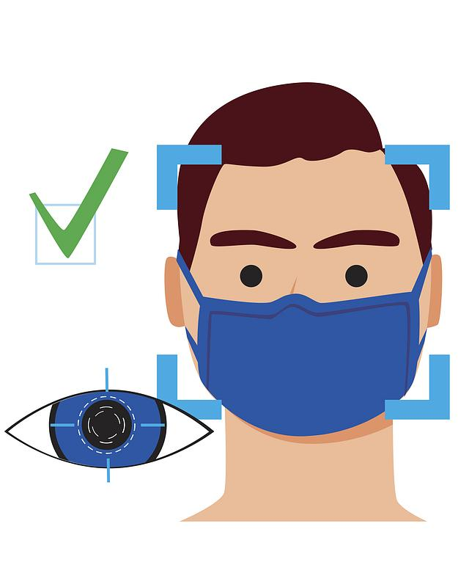

A COMPARATIVE ANALYSIS OF MACHINE LEARNING APPROACHES FOR AUTOMATED FACE MASK DETECTION
Md Abdullah Al Alamin & Junaed Younus KhaN

Slide 2

©MedpageToday

Slide 3
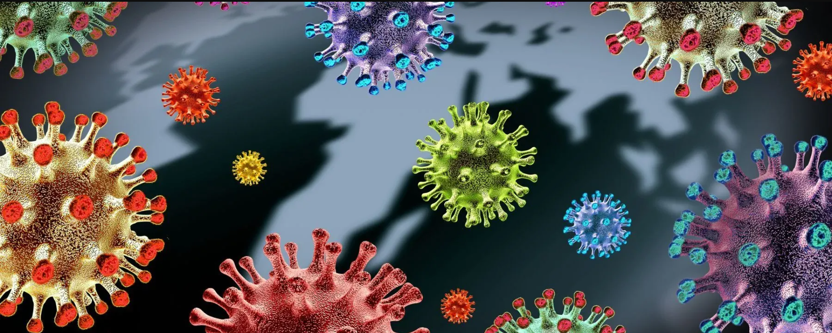
©TheScientist

Slide 4
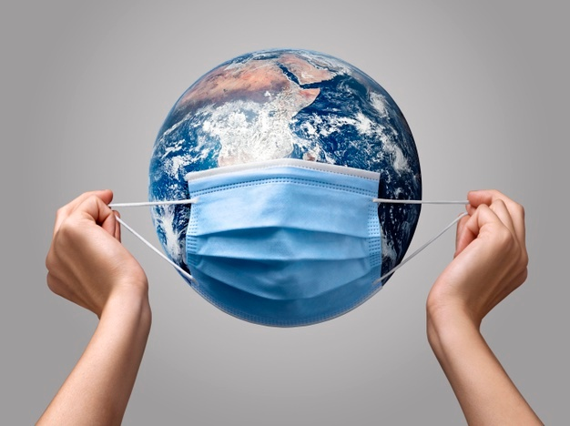

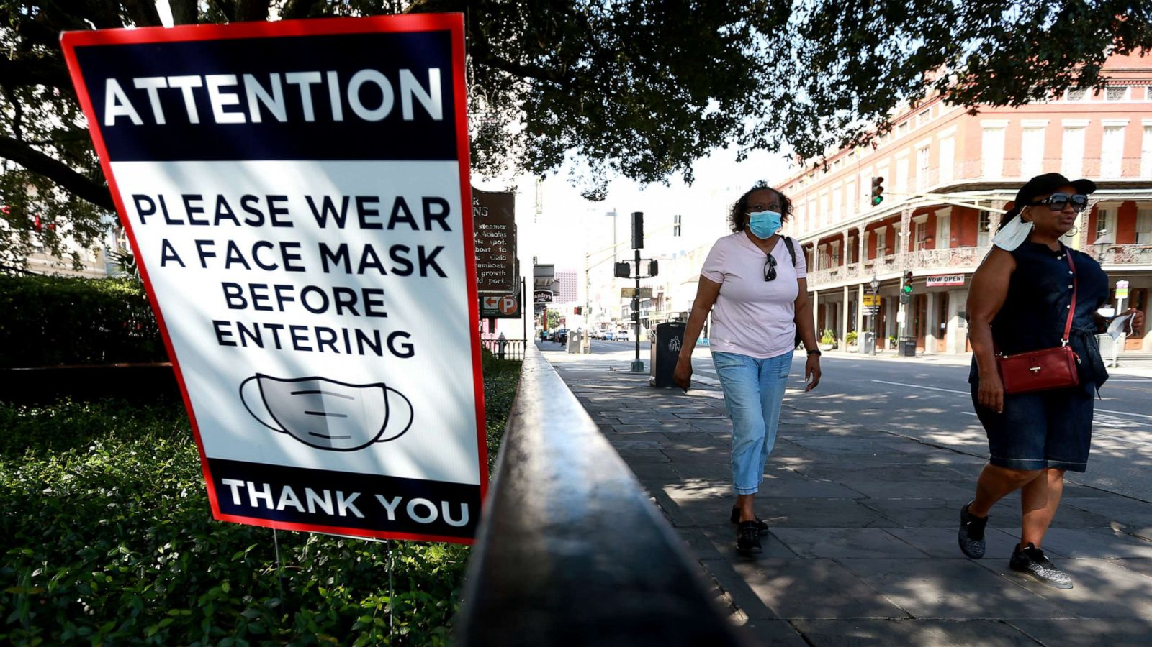
Wearing mask is the most effective measure
to prevent COVID-19.
abcnews
©MedpageToday

Slide 5
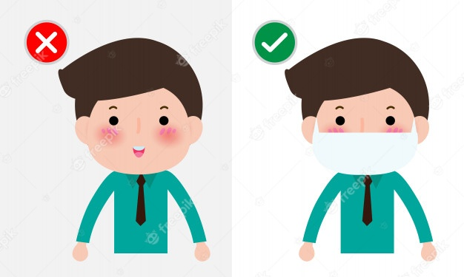
©FreePik

Slide 6
Automatic Mask Detection
Easily detect unmasked people
Make them aware
Take necessary steps
Ensure mask wearing
©romania-insider

Slide 7
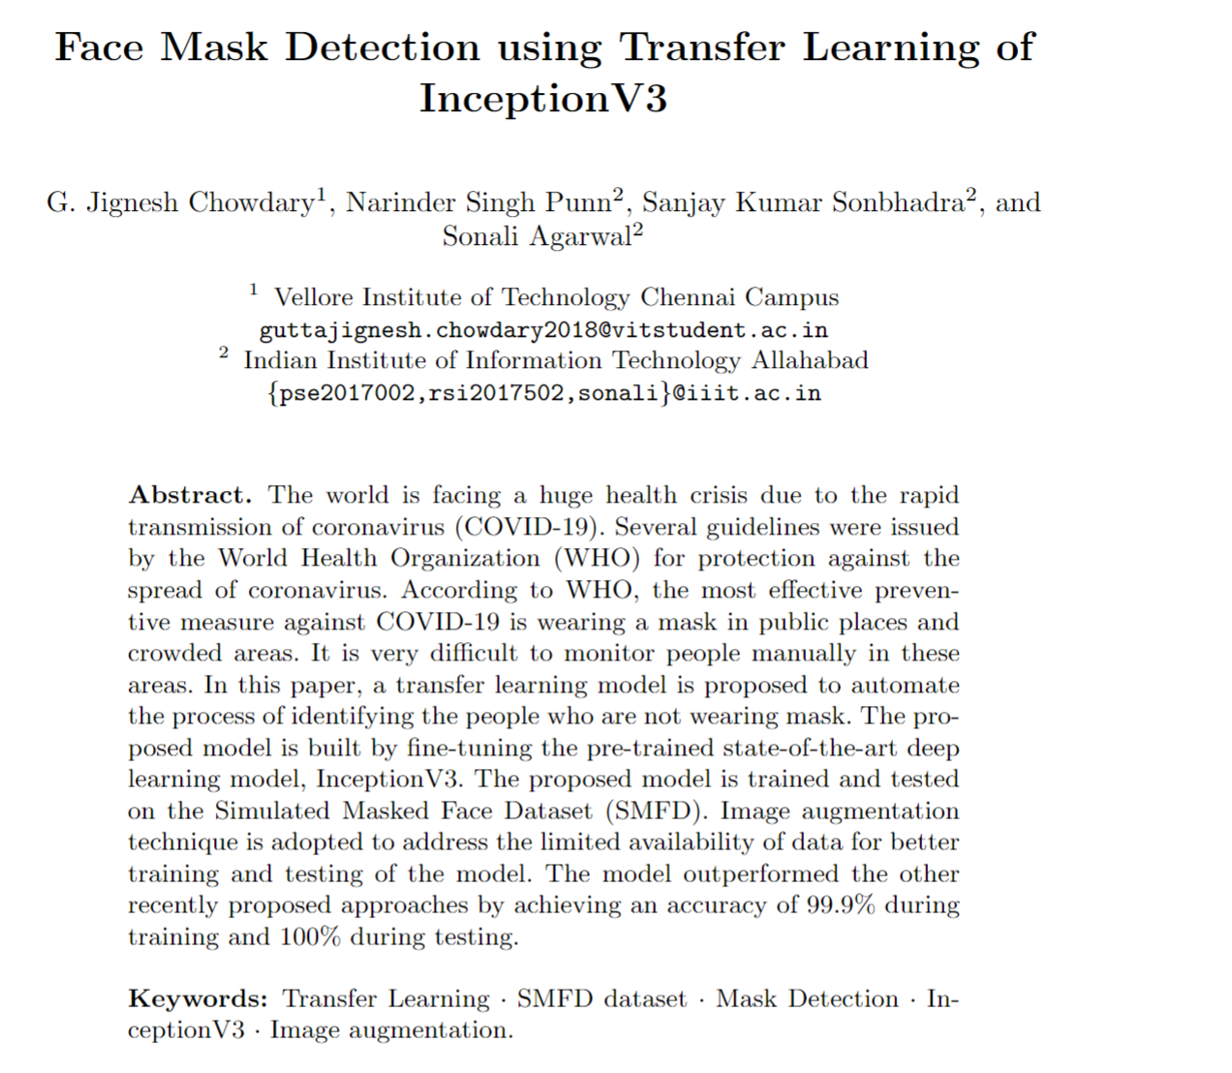
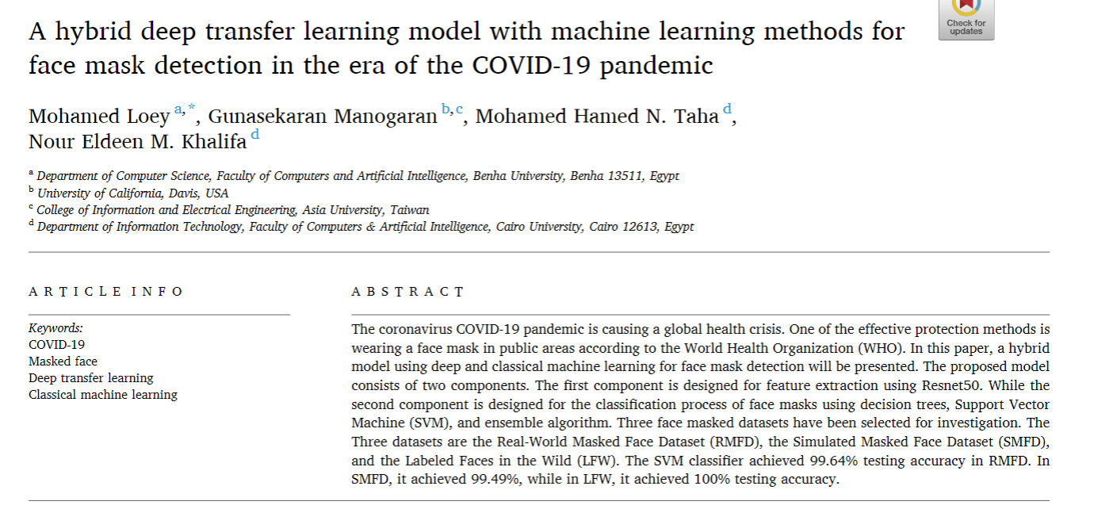
Related Work

Slide 8
Dataset
Real-World Masked Face Dataset (RMFD)
- 6,442 Masked & 90,000 Unmasked
Simulated Masked Face Dataset (SMFD)
- 67,000 Masked & 67,000 Unmasked
Dataset | #Masked | #Unmasked
Real | 6442 | 6442
Simulated | 6442 | 6442

Slide 9
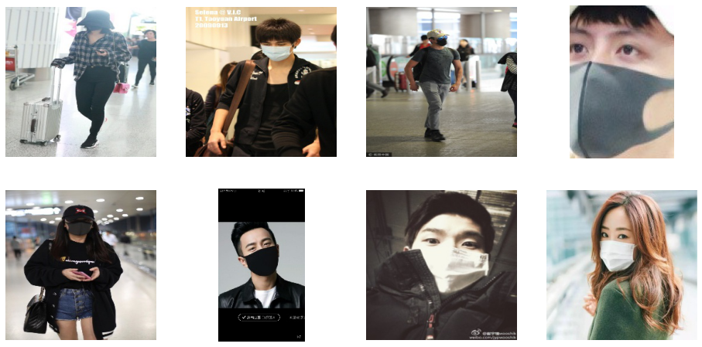
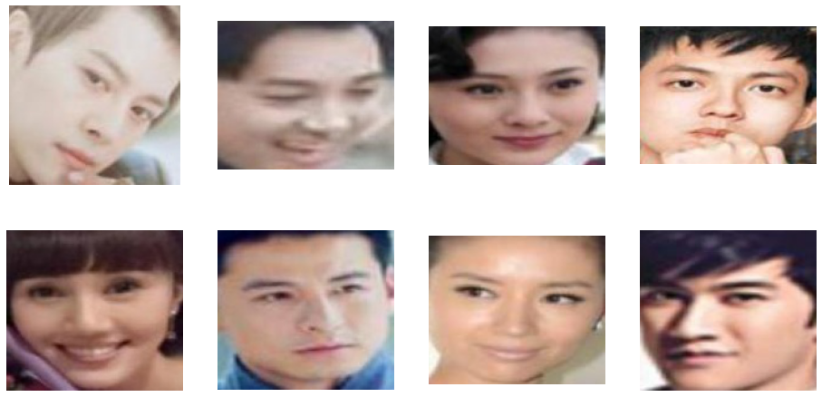
Real-World Masked Face Dataset (RMFD)

Slide 10
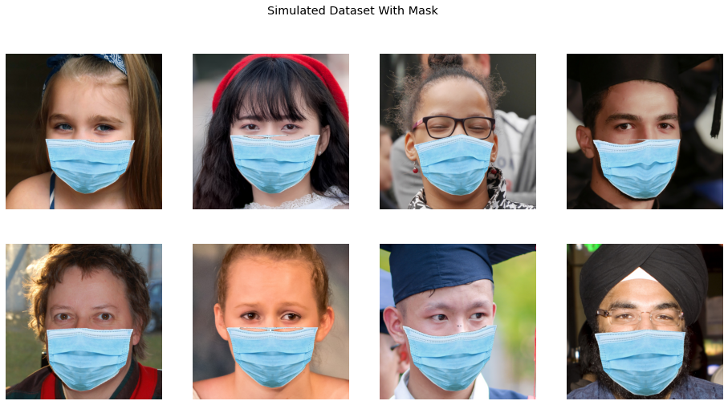
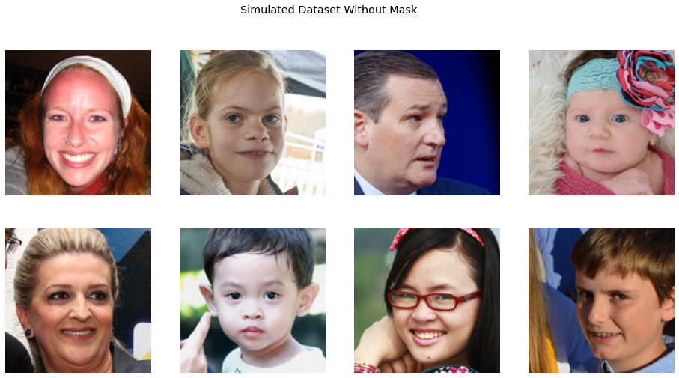
Simulated Face Mask Dataset (SMFD)

Slide 11
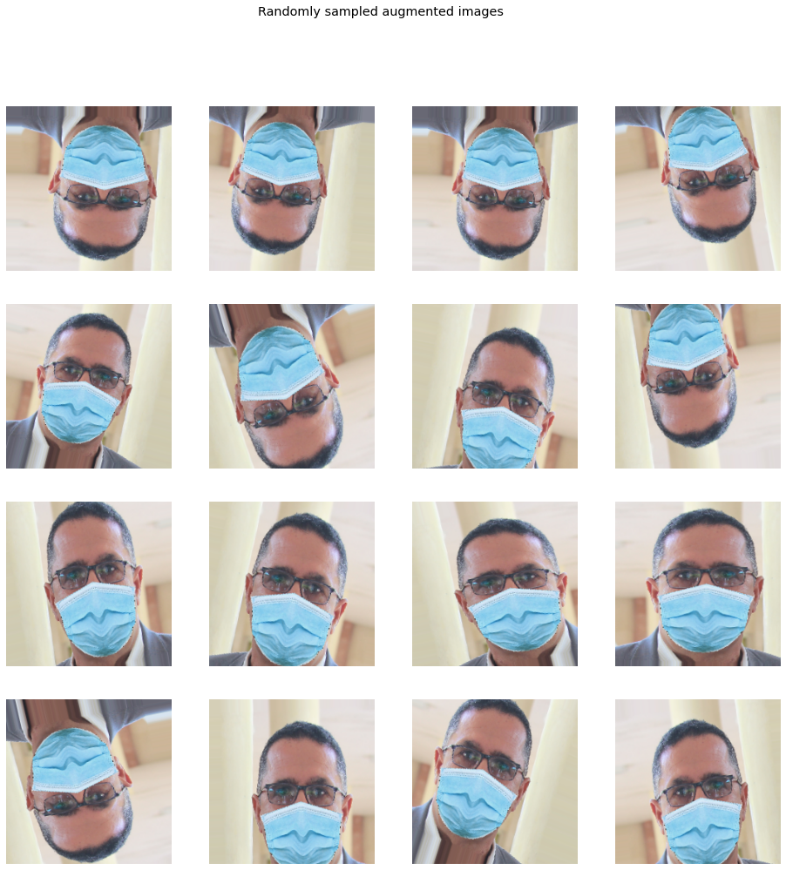
Data Augmentation
Rotation Range: 20°
Shear Range: 0.2
Zoom Range: 0.1
Flipping: Horizontal & Vertical

Slide 12
Models
Baseline
VGG1
Well-known
VGG19
ResNet50
Transfer Learning
Pretrained VGG19 Pretrained ResNet50
(on ImageNet)

Slide 13

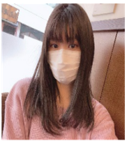
Research approach
Rotation, flipping, shear
Batch size = 128
Image scale=(128, 128, 3)
Early stop Dynamic learning rate Store best performing model
Data Augmentation
Model training From Scratch or using Transfer learning
Model Evaluation
Until validation loss decreases
With Mask
Model output
Without Mask

Slide 14
Research Questions
RQ1. How accurately different models can detect face mask?
RQ2. How effective the concept of domain adaptation is in face mask detection?

Slide 15
Simulated Face Mask Dataset (SMFD)

Slide 16
Performance of ML models (RQ1)
Type | Model | Accuracy
Type | Model | Simulated | Real
Baseline | VGG1 | 99.8 | 98
Well-known | VGG19 | 99.8 | 99.2
 | ResNet50 | 99.6 | 96.8
Transfer Learning | TL-VGG19 | 99.7 | 98.6
 | TL-ResNet50 | 100 | 99.45
So current CNN models find these benchmark dataset very easy

Slide 17
Domain Adaptation Result (RQ2)

Slide 18
Domain Adaptation Result (RQ2)
The models did not generalize well

Slide 19
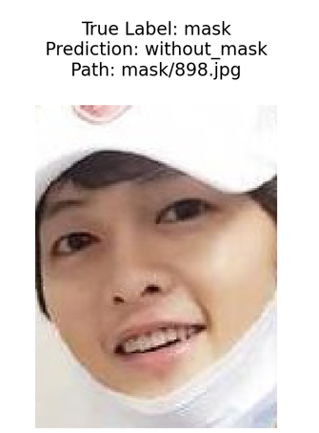
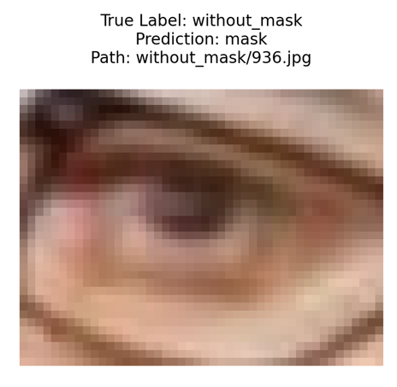
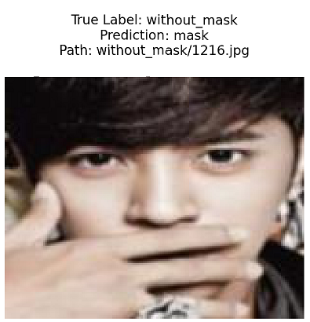
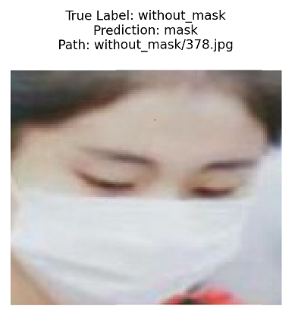
Incorrect/Difficult Test Samples (Real Image)

Slide 20
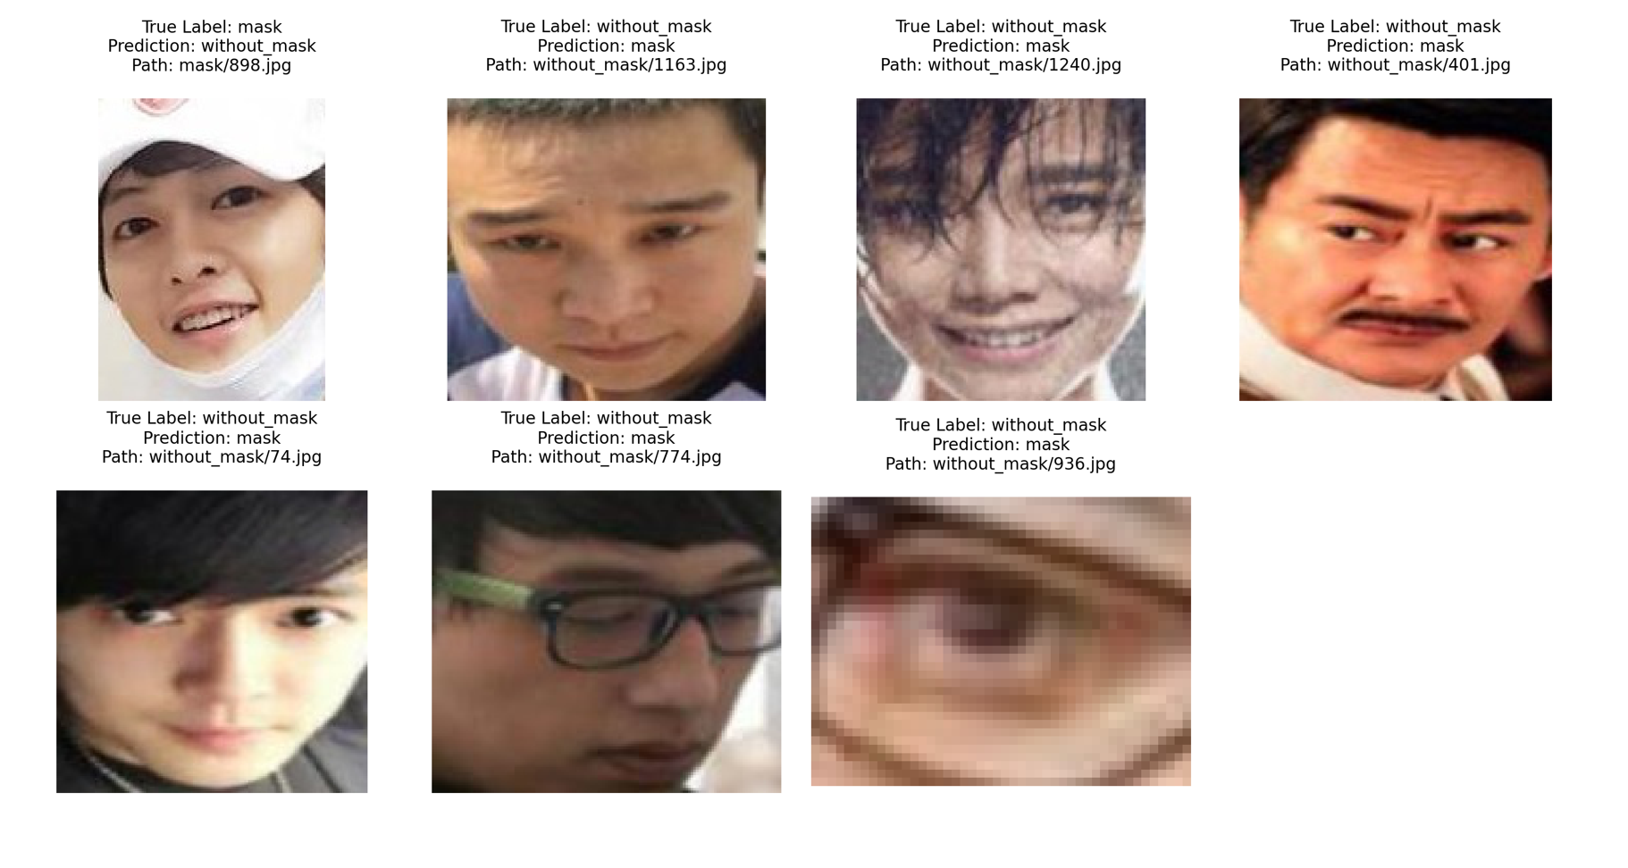
Error analysis
ResNet50 Transfer Leaning model mis-prediction
Real world dataset

Slide 21
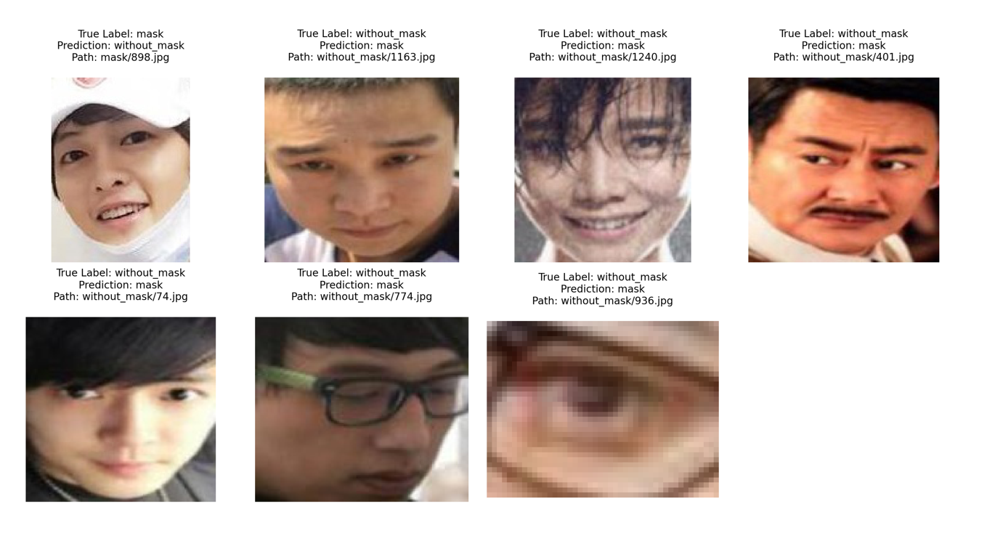
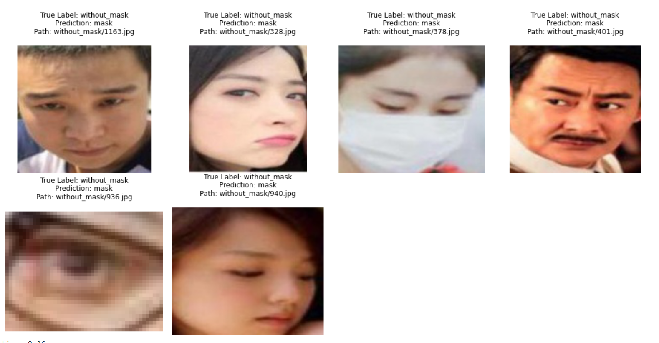
ResNet50 transfer learning Model’s misprediction on Target Dataset (Real Image Dataset)
Accuracy: 99.45
Accuracy: 99.53
When only trained on target dataset
When trained on Source Dataset (Simulated) and finetuned and on target Dataset (Real Image)

Slide 22
Time Complexity Analysis
Transfer learning provides slightly better performance with around 30% less training time

Slide 23
Implications
Our applied CNN models found these benchmark dataset quite easy
The models did not generalize properly and without finetuning target domain performance dropped significantly
In all of our experiments transfer learning provided better result

Slide 24
Limitations
Simulated dataset images contained almost identical simulated masks
Real world dataset images:
Many of the with mask images contained whole body, multiple people.
All of the without mask images contained only face.

Slide 25
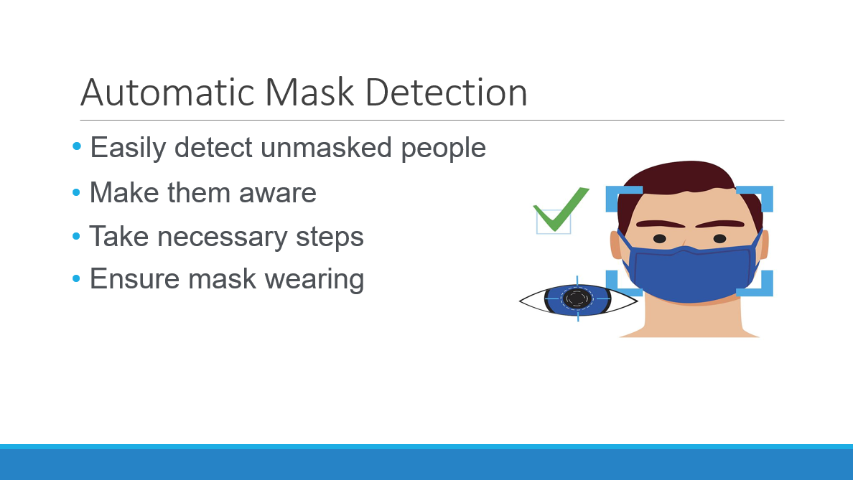
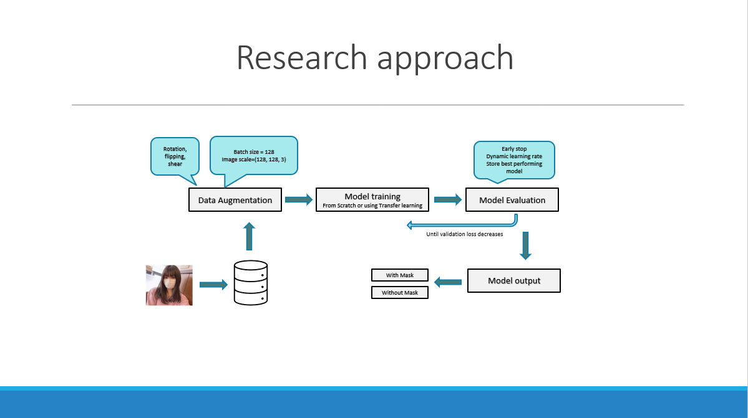
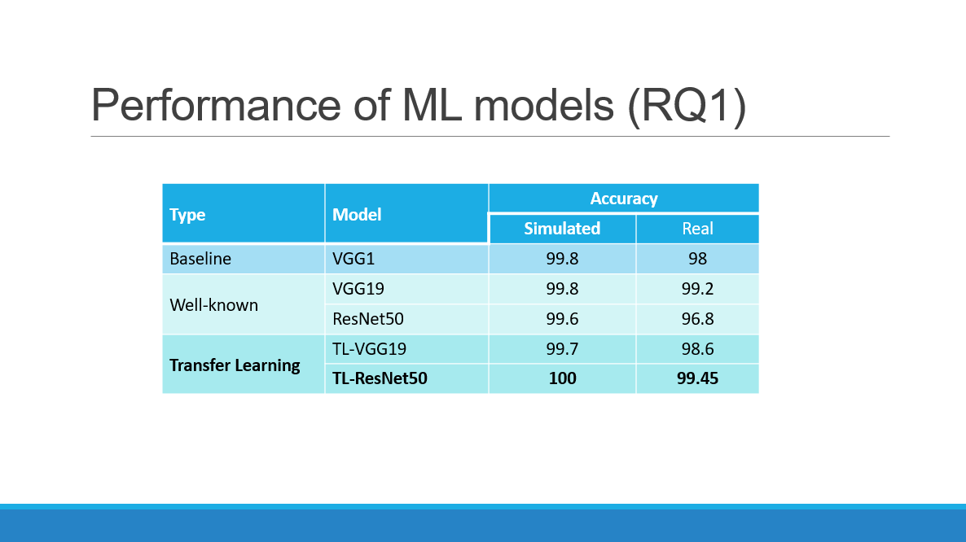
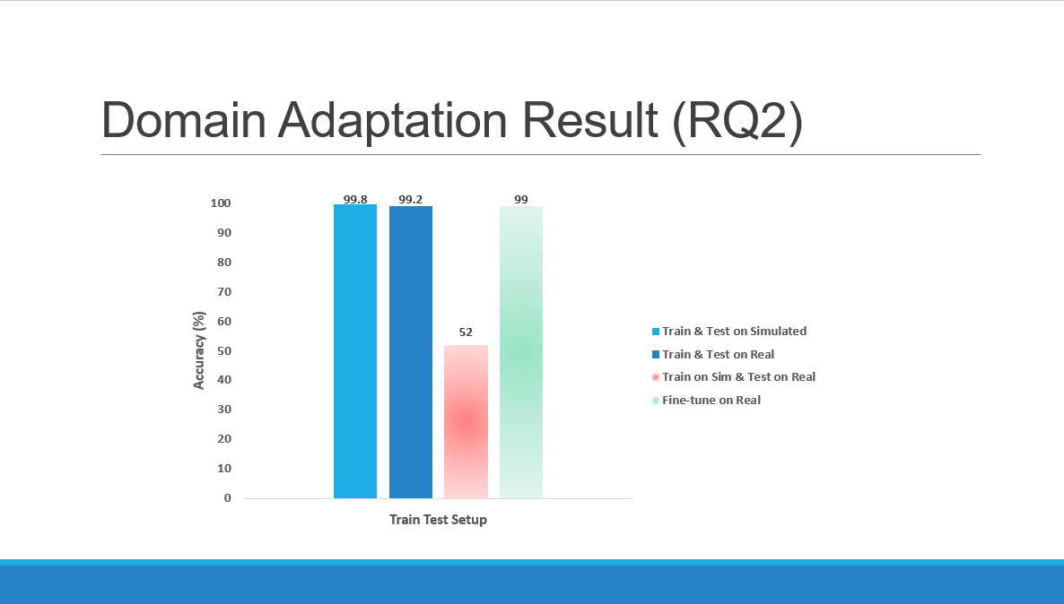
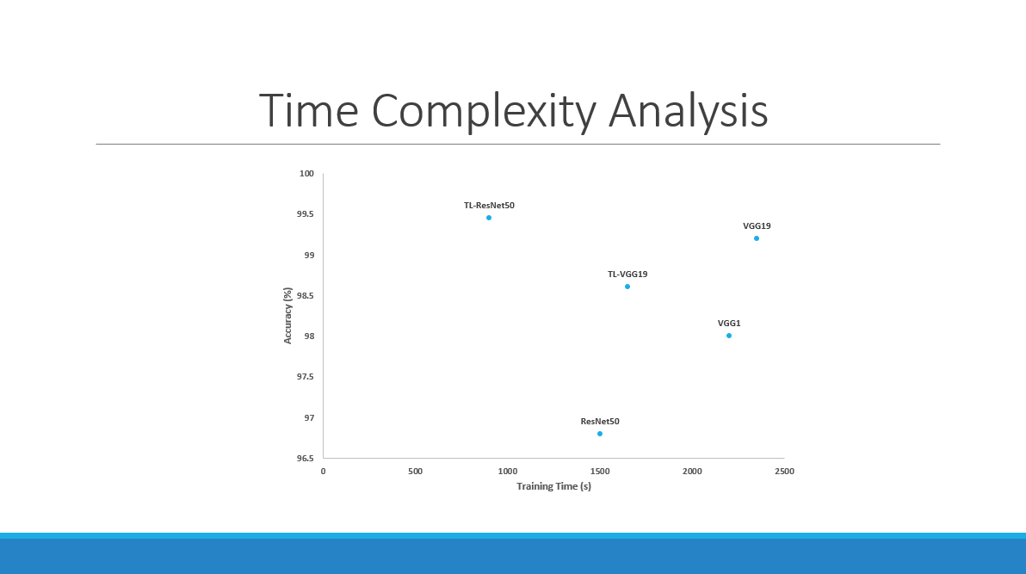
Summary

Slide 26
Thank You

